Slide 1
Active Learning,
Experimental Design
CS294 Practical Machine Learning
Daniel Ting
Original Slides by Barbara Engelhardt and Alex Shyr

Slide 2
Motivation
Better data is often more useful than simply more data (quality over quantity)
Data collection may be expensive
  Cost of time and materials for an experiment
  Cheap vs. expensive data
    Raw images vs. annotated images
Want to collect best data at minimal cost

Slide 3
Toy Example: 1D classifier
0
0
0
0
0
1
1
1
1
1
x
x
x
x
x
x
x
x
x
x
Unlabeled data: labels are all 0 then all 1 (left to right)
Classifier (threshold function):
h_{w}(x) = 1 if x > w (0 otherwise)
Goal: find transition between 0 and 1 labels in minimum steps
Naïve method: choose points to label at random on line
  Requires O(n) training data to find underlying classifier
Better method: binary search for transition between 0 and 1
    Requires O(log n) training data to find underlying classifier
    Exponential reduction in training data size!

Slide 4

Example: collaborative filtering
Users usually rate only a few movies; ratings “expensive”
Which movies do you show users to best extrapolate movie preferences?
  Also known as questionnaire design
Baseline questionnaires:
  Random: m movies randomly
  Most Popular Movies: m most frequently rated movies
Most popular movies is not better than random design!
Popular movies rated highly by all users; do not discriminate tastes
[Yu et al. 2006]
Notes:
Similar problem: Amazon recommendation lists

Slide 5
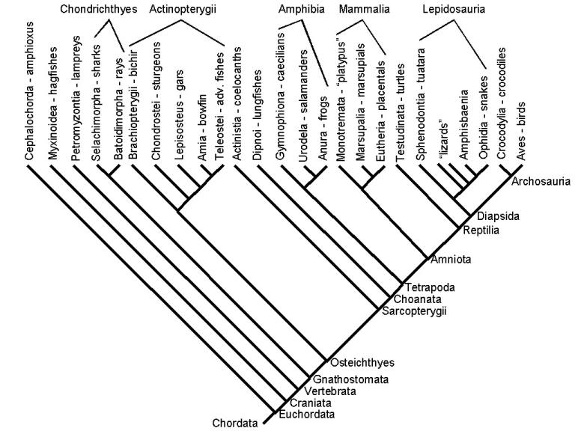
Example: Sequencing genomes
What genome should be sequenced next?
Criteria for selection?
Optimal species to detect phenomena of interest
[McAuliffe et al., 2004]

Slide 6
Example: Improving cell culture conditions
Grow cell culture in bioreactor
  Concentrations of various things
    Glucose, Lactate, Ammonia, Asparagine, etc.
  Temperature, etc.
Task: Find optimal growing conditions for a cell culture
Optimal: Perform as few time consuming experiments as possible to find the optimal conditions.

Slide 7
Topics for today
Introduction: Information theory
Active learning
  Query by committee
  Uncertainty sampling
  Information-based loss functions
Optimal experimental design
  A-optimal design
  D-optimal design
  E-optimal design
Non-linear optimal experimental design
  Sequential experimental design
  Bayesian experimental design
  Maximin experimental design
Summary

Slide 8
Topics for today
Introduction: Information theory
Active learning
  Query by committee
  Uncertainty sampling
  Information-based loss functions
Optimal experimental design
  A-optimal design
  D-optimal design
  E-optimal design
Non-linear optimal experimental design
  Sequential experimental design
  Bayesian experimental design
  Maximin experimental design
Summary

Slide 9
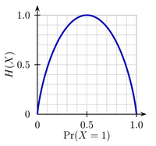
Entropy Function
A measure of information in random event X with possible outcomes {x₁,…,x_{n}}
Comments on entropy function:
  Entropy of an event is zero when the outcome is known
  Entropy is maximal when all outcomes are equally likely
The average minimum number of yes/no questions to answer some question
  Related to binary search
H(x) = - Σ_{i} p(x_{i}) log₂ p(x_{i})
[Shannon, 1948]

Slide 10
Kullback Leibler divergence
P = true distribution;
Q = alternative distribution that is used to encode data
KL divergence is the expected extra message length per datum that must be transmitted using Q
Measures how different the two distributions are
D_{KL}(P || Q) = Σ_{i} P(x_{i}) log (P(x_{i})/Q(x_{i}))
= Σ_{i} P(x_{i}) log P(x_{i}) – Σ_{i} P(x_{i}) log Q(x_{i})
= H(P,Q) - H(P)
= Cross-entropy - entropy

Slide 11
KL divergence properties
Non-negative: D(P||Q) ≥ 0
Divergence 0 if and only if P and Q are equal:
  D(P||Q) = 0 iff P = Q
Non-symmetric: D(P||Q) ≠ D(Q||P)
Does not satisfy triangle inequality
  D(P||Q) ≤ D(P||R) + D(R||Q)

Slide 12
KL divergence properties
Non-negative: D(P||Q) ≥ 0
Divergence 0 if and only if P and Q are equal:
  D(P||Q) = 0 iff P = Q
Non-symmetric: D(P||Q) ≠ D(Q||P)
Does not satisfy triangle inequality
  D(P||Q) ≤ D(P||R) + D(R||Q)
Not a distance
metric

Slide 13
KL divergence as gain
Modeling the KL divergence of the posteriors measures the amount of information gain expected from query (where x’ is the queried data):
Goal: choose a query that maximizes the KL divergence between posterior and prior
Basic idea: largest KL divergence between updated posterior probability and the current posterior probability represents largest gain
D( p(θ | x, x’) || p(θ | x))

Slide 14
Topics for today
Introduction: information theory
Active learning
  Query by committee
  Uncertainty sampling
  Information-based loss functions
Optimal experimental design
  A-optimal design
  D-optimal design
  E-optimal design
Non-linear optimal experimental design
  Sequential experimental design
  Bayesian experimental design
  Maximin experimental design
Summary

Slide 15
Active learning
Setup: Given existing knowledge, want to choose where to collect more data
  Access to cheap unlabelled points
  Make a query to obtain expensive label
  Want to find labels that are “informative”
Output: Classifier / predictor trained on less labeled data
Similar to “active learning” in classrooms
  Students ask questions, receive a response, and ask further questions
  vs. passive learning: student just listens to lecturer
This lecture covers:
  how to measure the value of data
  algorithms to choose the data

Slide 16
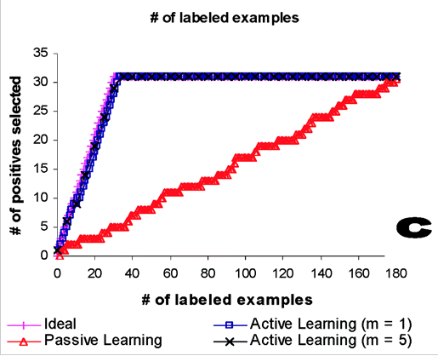
Example: Gene expression and Cancer classification
Active learning takes 31 points to achieve same accuracy as passive learning with 174
Liu 2004

Slide 17
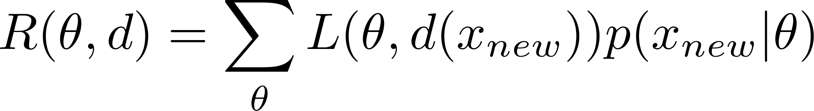
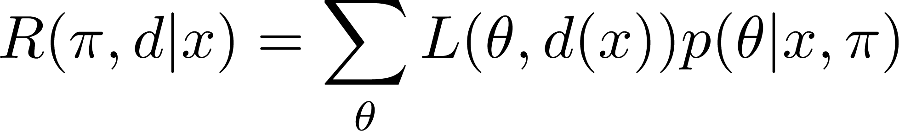
Reminder: Risk Function
Given an estimation procedure / decision function d
Frequentist risk given the true parameter θ is expected loss after seeing new data.
Bayesian integrated risk given a prior π is defined as posterior expected loss:
Loss includes cost of query, prediction error, etc.

Slide 18
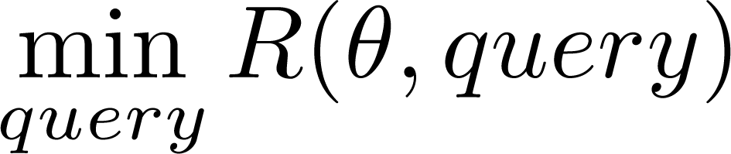
Decision theoretic setup
Active learner
  Decision d includes which data point q to query
    also includes prediction / estimate / etc.
  Receives a response from an oracle
Response updates parameters θ of the model
Make next decision as to which point to query based on new parameters
Query selected should minimize risk

Slide 19
Active Learning
Some computational considerations:
  May be many queries to calculate risk for
    Subsample points
    Probability far from the true min decreases exponentially
  May not be easy to calculate risk R
Two heuristic methods for reducing risk:
  Select “most uncertain” data point given model and parameters
  Select “most informative” data point to optimize expected gain

Slide 20
Uncertainty Sampling
Query the event that the current classifier is most uncertain about
Needs measure of uncertainty, probabilistic model for prediction
Examples:
  Entropy
  Least confident predicted label
  Euclidean distance (e.g. point closest to margin in SVM)

Slide 21
Example: Gene expression and Cancer classification
Data: Cancerous Lung tissue samples
  “Cheap” unlabelled data
    gene expression profiles from Affymatrix microarray
  Labeled data:
    0-1 label for adenocarcinoma or malignant pleural mesothelioma
Method:
  Linear SVM
  Measure of uncertainty
    distance to SVM hyperplane
Liu 2004

Slide 22
Example: Gene expression and Cancer classification
Active learning takes 31 points to achieve same accuracy as passive learning with 174
Liu 2004

Slide 23
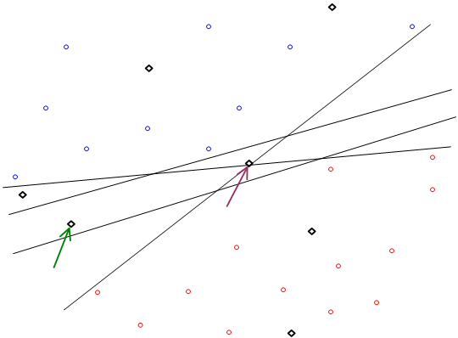
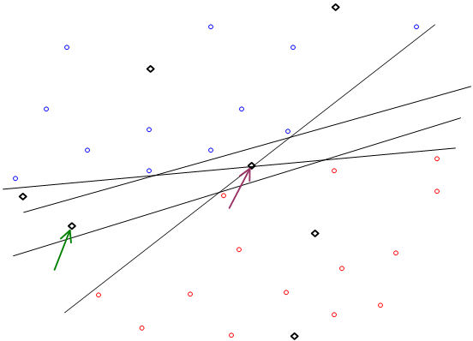
Query by Committee
Which unlabelled point should you choose?

Slide 24
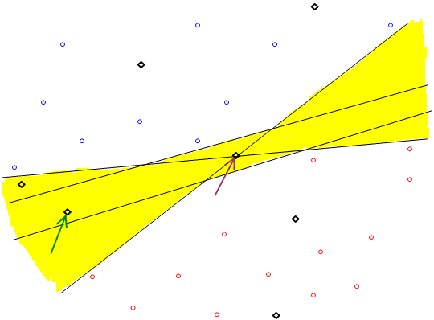

Query by Committee
Yellow = valid hypotheses

Slide 25
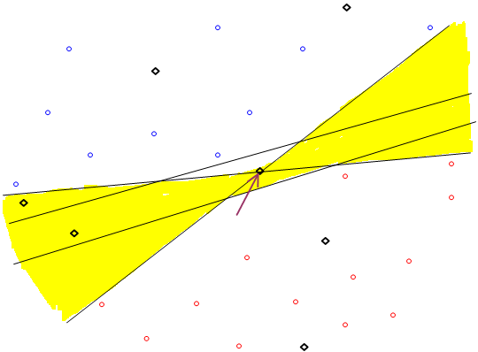

Query by Committee
Point on max-margin hyperplane does not reduce the number of valid hypotheses by much

Slide 26
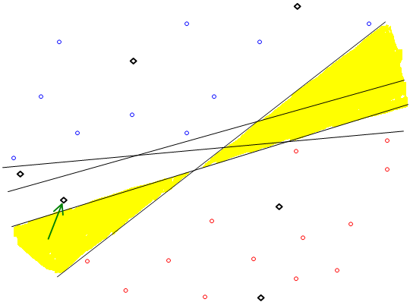

Query by Committee
Queries an example based on the degree of disagreement between committee of classifiers

Slide 27
Query by Committee
Prior distribution over classifiers/hypotheses
Sample a set of classifiers from distribution
Natural for ensemble methods which are already samples
  Random forests, Bagged classifiers, etc.
Measures of disagreement
  Entropy of predicted responses
  KL-divergence of predictive distributions

Slide 28
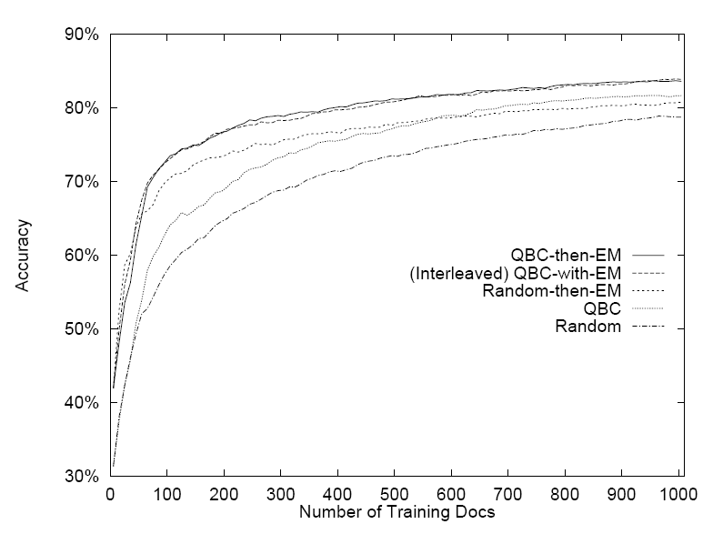
Query by Committee Application
Used naïve Bayes model for text classification in a Bayesian learning setting (20 Newsgroups dataset)
[McCallum &
Nigam, 1998]

Slide 29
Information-based Loss Function
Previous methods looked at uncertainty at a single point
  Does not look at whether you can actually reduce uncertainty or if adding the point makes a difference in the model
Want to model notions of information gained
  Maximize KL divergence between posterior and prior
  Maximize reduction in model entropy between posterior and prior (reduce number of bits required to describe distribution)
All of these can be extended to optimal design algorithms
Must decide how to handle uncertainty about query response, model parameters
[MacKay, 1992]

Slide 30
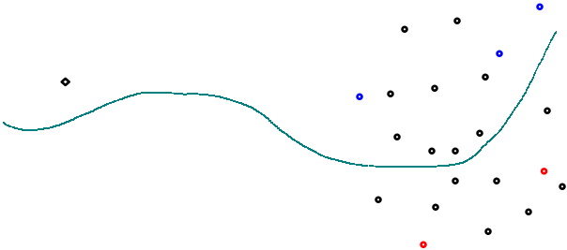
Other active learning strategies
Expected model change
  Choose data point that imparts greatest change to model
Variance reduction / Fisher Information maximization
  Choose data point that minimizes error in parameter estimation
  Will say more in design of experiments
Density weighted methods
  Previous strategies use query point and distribution over models
  Take into account data distribution in surrogate for risk.

Slide 31
Active learning warning
Choice of data is only as good as the model itself
Assume a linear model, then two data points are sufficient
What happens when data are not linear?

Slide 32
Break?

Slide 33
Topics for today
Introduction: information theory
Active learning
  Query by committee
  Uncertainty sampling
  Information-based loss functions
Optimal experimental design
  A-optimal design
  D-optimal design
  E-optimal design
Non-linear optimal experimental design
  Sequential experimental design
  Bayesian experimental design
  Maximin experimental design
Summary

Slide 34
Experimental Design
Many considerations in designing an experiment
  Dealing with confounders
  Feasibility
  Choice of variables to measure
  Size of experiment ( # of data points )
  Conduction of experiment
  Choice of interventions/queries to make
  Etc.

Slide 35
Experimental Design
Many considerations in designing an experiment
  Dealing with confounders
  Feasibility
  Choice of variables to measure
  Size of experiment ( # of data points )
  Conduction of experiment
  Choice of interventions/queries to make
  Etc.
We will only look at one of them

Slide 36
What is optimal experimental design?
Previous slides give
  General formal definition of the problem to be solved
  (which may be not tractable or not worth the effort)
  heuristics to choose data
Empirically good performance but
  Not that much theory on how good the heuristics are
Optimal experimental design gives
  theoretical credence to choosing a set of points
  for a specific set of assumptions and objectives
Theory is good when you only get to run (a series of) experiments once

Slide 37

Optimal Experimental Design
Given a model M with parameters β,
  What queries are maximally informative
  i.e. will yield the best estimate of β
“Best” minimizes variance of estimate
  Equivalently, maximizes the Fisher Information
Linear models
  Optimal design does not depend on β !
Non-linear models
  Depends on β, but can Taylor expand to linear model

Slide 38
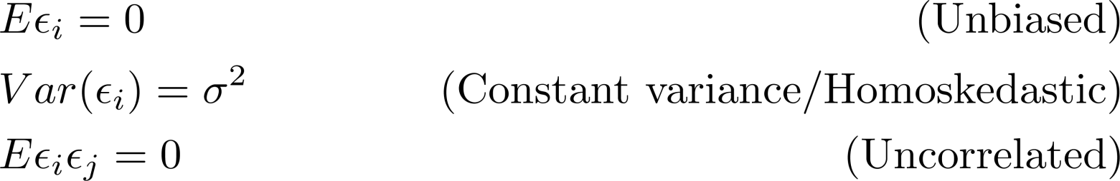

Optimal Experimental Design
Assumptions
  Linear model:
  Finite set of queries {F₁, …, F_{s}} that x_{.j} can take.
    Each F_{i} is set of interventions/measurements
    (e.g. F₁ =10ml of dopamine on mouse with mutant gene G)
    m_{i} = # responses for query F_{i}
  Usual assumptions for linear least squares regression
Covariance of mle:

Slide 39

Relaxed Experimental Design
Hard combinatorial problem (F^{T}MF)⁻¹
The relaxed problem allows w_{i} ≥ 0, Σ_{i} w_{i} = 1
Error covariance matrix becomes (F^{T}WF)⁻¹
(F^{T}WF)⁻¹ = inverted Hessian of the squared error
  or inverted Fisher information matrix
minimizing (F^{T}WF)⁻¹ reduces model error,
  or equivalently maximize information gain
Boolean problem
Relaxed problem
N = 3

Slide 40
Experimental Design: Types
Want to minimize (F^{T}WF)⁻¹ ; need a scalar objective
  A-optimal (average) design minimizes trace(F^{T}WF)⁻¹
  D-optimal (determinant) design minimizes log det(F^{T}WF)⁻¹
  E-optimal (extreme) design minimizes max eigenvalue of (F^{T}WF)⁻¹
  Alphabet soup of other criteria (C-, G-, L-, V-,etc)
All of these design methods can use convex optimization techniques
Computational complexity polynomial for semi-definite programs (A- and E-optimal designs)
[Boyd & Vandenberghe, 2004]

Slide 41
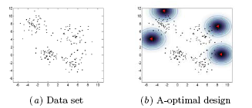
A-Optimal Design
A-optimal design minimizes the trace of (F^{T}WF)⁻¹
  Minimizing trace (sum of diagonal elements) essentially chooses maximally independent columns
  (small correlations between interventions)
Tends to choose points on the border of the dataset
Example: mixture of four Gaussians
[Yu et al., 2006]

Slide 42
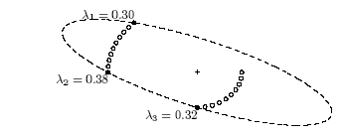
A-Optimal Design
A-optimal design minimizes the trace of (F^{T}WF)⁻¹
  Can be cast as a semi-definite program
Example: 20 candidate datapoints, minimal ellipsoid that contains all points
[Boyd & Vandenberghe, 2004]

Slide 43
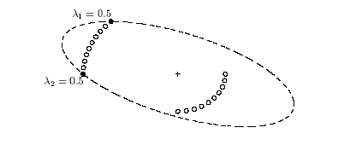
D-Optimal design
D-optimal design minimizes log determinant of (F^{T}WF)⁻¹
Equivalent to
  choosing the confidence ellipsoid with minimum volume
  (“most powerful” hypothesis test in some sense)
  Minimizing entropy of the estimated parameters
Most commonly used optimal design
[Boyd & Vandenberghe, 2004]

Slide 44

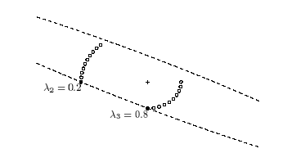
E-Optimal design
E-optimal design minimizes largest eigenvalue of (F^{T}WF)⁻¹
Minimax procedure
Can be cast as a semi-definite program
Minimizes the diameter of the confidence ellipsoid
[Boyd & Vandenberghe, 2004]

Slide 45
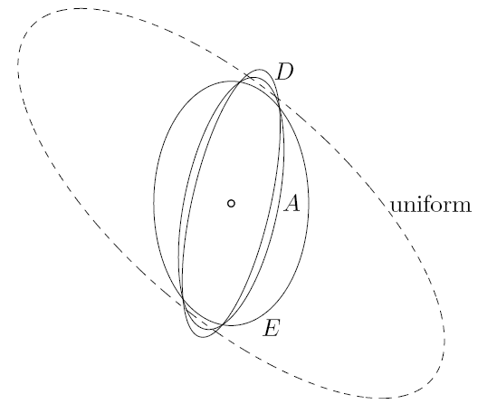
Summary of Optimal Design
[Boyd & Vandenberghe, 2004]

Slide 46
Optimal Design
Extract the integral solution from the relaxed problem
Can simply round the weights to closest multiple of 1/m
  m_j = round(m * w_i), i = 1, …, p
[Boyd & Vandenberghe, 2004]

Slide 47
Extensions to optimal design
Cost associated with each experiment
  Add a cost vector, constrain total cost by a budget B (one additional constraint)
Multiple samples from single experiment
  Each x_{i} is now a matrix instead of a vector
  Optimization (covariance matrix) is identical to before
Time profile of process
  Add time dimension to each experiment vector x_{i}
[Atkinson, 1996]
[Boyd & Vandenberghe, 2004]

Slide 48
Topics for today
Introduction: information theory
Active learning
  Query by committee
  Uncertainty sampling
  Information-based loss functions
Optimal experimental design
  A-optimal design
  D-optimal design
  E-optimal design
Non-linear optimal experimental design
  Sequential experimental design
  Bayesian experimental design
  Maximin experimental design
Summary

Slide 49

Optimal design in non-linear models
Given a non-linear model y = g(x,θ)
Model is described by a Taylor expansion around a
  a_{j}( x, ) = ∂ g(x,θ) / ∂ θ_{j}, evaluated at
Maximization of Fisher information matrix is now the same as the linear model
Yields a locally optimal design, optimal for the particular value of θ
Yields no information on the (lack of) fit of the model
[Atkinson, 1996]

Slide 50
Optimal design in non-linear models
Problem: parameter value θ, used to choose experiments F, is unknown
Three general techniques to address this problem, useful for many possible notions of “gain”
Sequential experimental design: iterate between choosing experiment x and updating parameter estimates θ
Bayesian experimental design: put a prior distribution on parameter θ, choose a best data x
Maximin experimental design: assume worst case scenario for parameter θ, choose a best data x

Slide 51
Sequential Experimental Design
Model parameter values are not known exactly
Multiple experiments are possible
Learner assumes that only one experiment is possible; makes best guess as to optimal data point for given θ
Each iteration:
  Select data point to collect via experimental design using θ
  Single experiment performed
  Model parameters θ‘ are updated based on all data x’
Similar idea to Expectation Maximization
[Pronzato & Thierry, 2000]

Slide 52
Bayesian Experimental Design
Effective when knowledge of distribution for θ is available
Example: KL divergence between posterior and prior
  ∫_{x} argmax_{w} ∫_{θ∈Θ} D( p(θ |w,x) || p(θ )) p(x |w) dθ dx
Example: A-optimal design:
  ∫_{x} argmin_{w} ∫_{θ∈Θ} tr(F^{T}WF)⁻¹p(θ | w,x)p(x |w) dθ dx
Often sensitive to distributions
[Chaloner & Verdinelli, 1995]

Slide 53
Maximin Experimental Design
Maximize the minimum gain
Example: D-optimal design:
  argmax min_{θ∈Θ} I( ) = argmin_{w} max_{θ∈Θ} log det (F^{T}WF)⁻¹
Example: KL divergence:
  argmax_{w} min_{θ∈Θ} D(p(θ |w,x) || p(θ))
Does not require prior/empirical knowledge
Good when very little is known about distribution of parameter θ
[Pronzato & Walter, 1988]

Slide 54
Topics for today
Introduction: information theory
Active learning
  Query by committee
  Uncertainty sampling
  Information-based loss functions
Optimal experimental design
  A-optimal design
  D-optimal design
  E-optimal design
Non-linear optimal experimental design
  Sequential experimental design
  Bayesian experimental design
  Maximin experimental design
Response surface models
Summary

Slide 55
Response Surface Methods
Estimate effects of local changes to the interventions (queries)
  In particular, estimate how to maximize the response
Applications:
  Find optimal conditions for growing cell cultures
  Develop robust process for chemical manufacturing
Procedure for maximizing response
  Given a set of datapoints, interpolate a local surface
  (This local surface is called the “response surface”)
    Typically use a quadratic polynomial to obtain a Hessian
  Hill-climb or take Newton step on the response surface to find next x
  Use next x to interpolate subsequent response surface

Slide 56
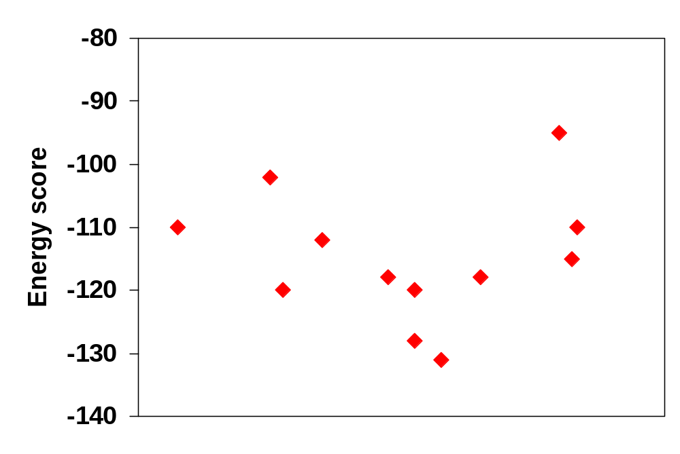
Response Surface Modeling
Goal: Approximate the function f(c) = score(minimize(c))
1. Fit a smoothed response surface to the data points
2. Minimize response surface to find new candidate
3. Use method to find nearby local minimum of score function
4. Add candidate to data points
5. Re-fit surface, repeat
[Blum, unpublished]

Slide 57
Related ML Problems
Reinforcement Learning
  Interaction with the world
  Notion of accumulating rewards
Semi-supervised learning
  Use the unlabelled data itself, not just as pool of queries
Core sets, active sets
  Select small dataset gives nearly same performance as full dataset. Fast computation for large scale problems

Slide 58
Summary
Distribution over parameter;
Probabilistic; sequential
Active learning
  Query by committee
  Uncertainty sampling
  Information-based loss functions
Optimal experimental design
  A-optimal design
  D-optimal design
  E-optimal design
Non-linear optimal experimental design
  Sequential experimental design
  Bayesian experimental design
  Maximin experimental design
Response surface methods
Predictive distribution on pt;
Distance function; sequential
Maximize gain; sequential
Minimize trace of information matrix
Minimize log det of information matrix
Minimize largest eigenvalue of information matrix
Multiple-shot experiments;
Little known of parameter
Single-shot experiment;
Some idea of parameter distribution
Single-shot experiment;
Little known of parameter
distribution (range known)
Sequential experiments for optimization

